Slide 1


INTEGRATED HEALTHCARE MANAGEMENT SYSTEM: ENHANCING ACCESS, MEDICATION AND DATA VISUALIZATION
Group Members
Luornor Nathan Tettey – 10869956
Abubakari Al-Waasiu - 10903301
Supervisor
Dr Percy Okae

Slide 2
OUTLINE
Introduction
Problem Definition
Relevance of Work
Existing Works
Objectives
Proposed System Overview
Resource Requirements
System Architecture
Project Timeline
Expected Outcomes
Conclusion
References

Slide 3
INTRODUCTION
Patient Folder system
Patient – Doctor Consultation
System access and security

Slide 4
INTRODUCTION
Patient data visualization
Medication management
Disease Outbreak

Slide 5
PROBLEM DEFINITION
There is a critical need for a comprehensive Health Management System (HMS) that addresses the existing gaps in healthcare administration, data management, and communication.
Healthcare data is often spread across departments, making it challenging to access a complete and unified patient record.

Slide 6
PROBLEM DEFINITION
Patients often have limited access to their health records, hindering their active participation in managing their health.
Lack of effective communication channels among healthcare professionals can lead to delays in patient care and potential medical errors

Slide 7
RELEVANCE OF WORK
Accuracy in patient health data management
Patient health awareness
Easy and secure Access

Slide 8
RELEVANCE OF WORK
Patient health awareness
Regular medication
Early detection and control of diseases

Slide 9
EXISTING WORKS
Title | Authors | Year Developed | Achievements | Limitations
The Lightwave Health Information Management System (LHIMS) [1] | Ghana Health Service (GHS) Lead by Dr. Samuel Osei-Kuffour. | 2014 | The LHIMS has increased the accuracy of patient records by 95%. | The system does not allow patients to view their own data
Welby [2] | NTT DATA Shigeki Sugiura Hiroshi Ogawa Atsushi Kubo | 2018 | Highly secure and reliable data center infrastructure | Cost of services are relatively higher compared to other system.

Slide 10
EXISTING WORKS
Title | Authors | Year Developed | Achievements | Limitations
Egton Medical Information Systems EMIS – Health [3] | Dr. Peter Sowerby Dr. David Stables | 2015 | EMIS Health software is used by over 70% of GPs in England and 37% of community pharmacies in early 2023. | EMIS Health does not always integrate well with other healthcare IT systems.
WeDoctor [4] | Liao Jieyuan Tao Hong Wang Tao | 2010 | Pioneering AI-Powered Healthcare - “World's Most Innovative Healthcare Company” in 2021 | Language barriers

Slide 11
EXISTING WORKS
Title | Authors | Year Developed | Achievements | Limitations
Msoft Hospital Management System[5] | Mr. Samuel Osei-Wusu | 2016 | Msoft Hospital Management System has provided real-time data on disease outbreaks. | The system does not support telemedicine functionalities.
Smart Hospital Manager[6] | Mr. Samuel Annan | 2020 | Improving the coordination of care between different healthcare providers by 75%. | The system is expensive and can be out of reach for some hospitals and clinics in Ghana

Slide 12
OBJECTIVES
The system should enable patient access to their health data.
The system should optimize the cost efficiency of services.
The system should improve interoperability with other healthcare IT systems.
The system should use a widely known language
The system should integrate a telemedicine platform.
The system should enhance overall user experience and security.

Slide 13

PROPOSED SYSTEM OVERVIEW
Telemedicine platform
Medication management
Health data visualization
Biometric fingerprint and alternative access

Slide 14
TELEMEDICINE PLATFORM
Overview
Features
Benefits
Secure and encrypted communication
real-time video consultations,
electronic health records integration
Convenient remote health services
reduced travel time and costs
increased accessibility
Patient – Doctor Consultations
Required: React, nodejs and Javascript

Slide 15
MEDICATION MANAGEMENT
Overview
Features
Benefits
Manage medication effectively
Required: smtplib, twilio
Medication Tracking
Medication Reminders
Medication Inventory
Reduced medication errors
Improved patient safety
Enhanced medication adherence
Streamlined medication administration

Slide 16
HEALTH DATA VISUALIZATION
Overview
Features
Benefits
Easy visualization, interpretation, and analysis of patient health information.
Required: matplotlib, seaborn, plotpy, numpy, scipy
Graphs for patient vitals.
Charts medication history, and interactive.
Dashboards for treatment outcomes.
Identification of anomalies in patient data
Collaboration between healthcare professionals
Monitoring and tracking of patient progress

Slide 17
BIOMETRIC FINGERPRINT ACCESS
Overview
Features
Benefits
Easy and secure access for patients and health care professionals
Required: MXChip, Fingerprint scanner, LCD, buttons
Secure and encrypted communication
real-time video consultations,
electronic health records integration
Enhanced security and authentication
Eliminates the need for passwords or PINs
Reduces the risk of identity theft
Provides quick and convenient access to the system

Slide 18
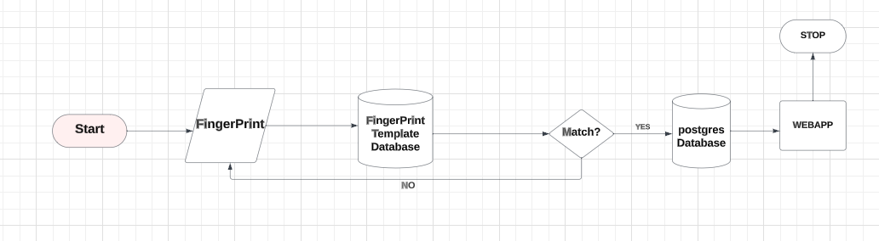
FLOW DIAGRAM FOR ACCESS CONTROL

Slide 19
FUNCTIONAL REQUIREMENTS
Health records management
Patient – Doctor appointment booking
Remote Communication through video and chat
Health data visualization
Diseases outbreak prediction based on frequency
Biometric fingerprint and alternative accesses

Slide 20
NON-FUNCTIONAL REQUIREMENTS
Data security and healthcare regulations compliance .
Fast and easy access.
User-friendly and intuitive interfaces.
Scalability to accommodate a growing user base.
Rigorous testing for reliability and security.

Slide 21
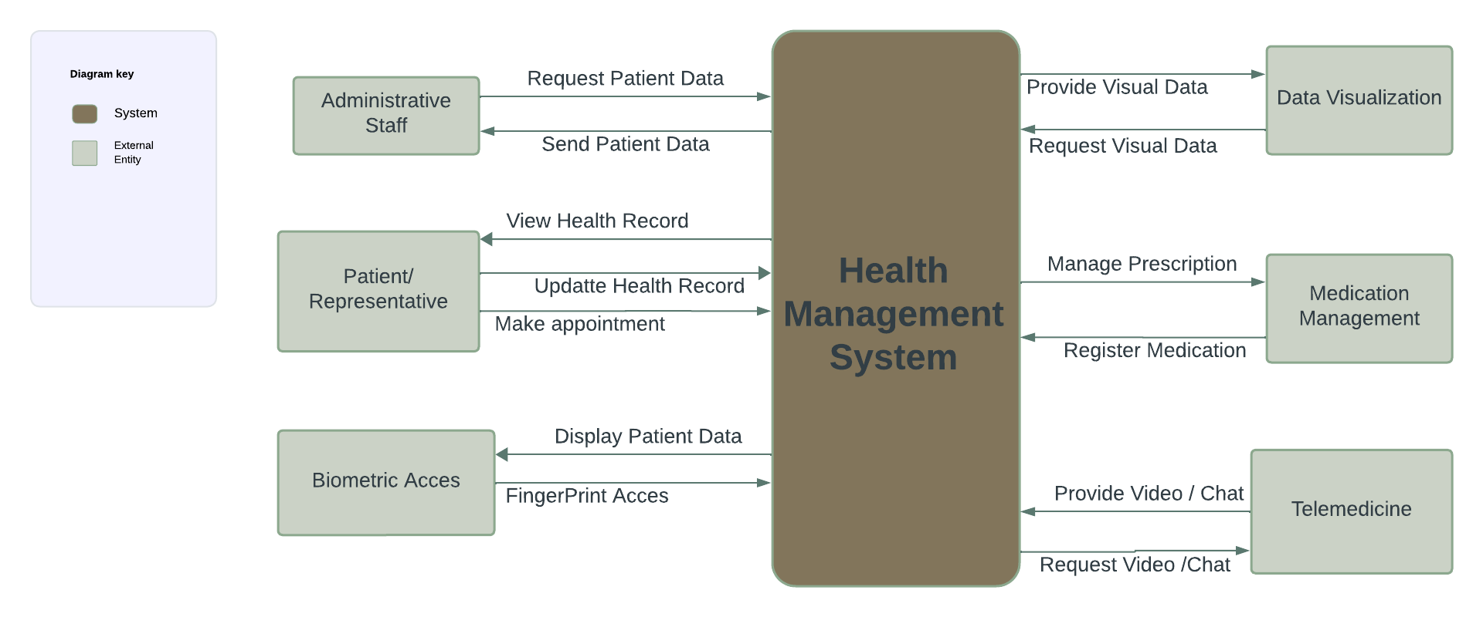
SYSTEM ARCHITECTURE

Slide 22
DELEGATION OF TASKS
Name | Roles
Al-Waasiu Abubakari | UI/UX Design Frontend Development
Luornor Nathan Tettey | Database Management Backend Development
Shared Tasks | Data Acquisition Software Testing System Deployment

Slide 23
BUDGET ESTIMATION
Ghs1000
Ghs500
Ghs300
Ghs200
Development Cost
Hardware Cost
Software Cost
Maintenance Cost

Slide 24
Potential Challenges
Mitigation Strategies
Conduct user training and provide ongoing support
Implement strong data encryption and access controls
Collaborate with technical experts and conduct thorough testing
Lack of user adoption
Data security breaches
Technical challenges

Slide 25
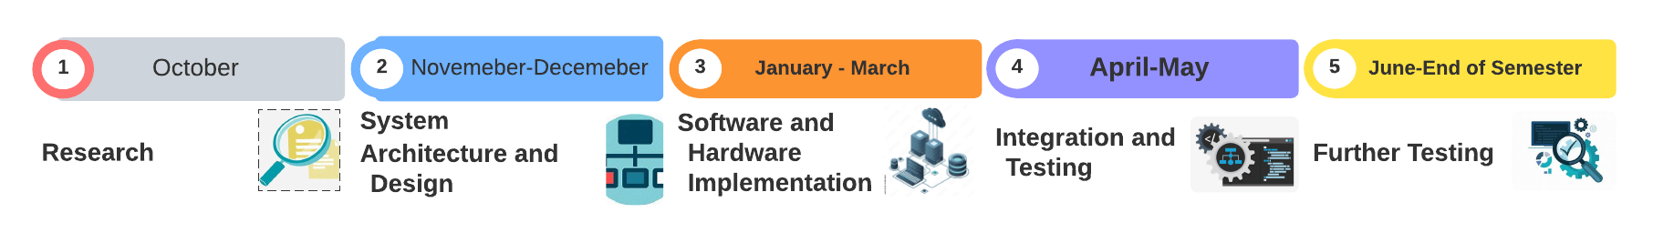
PROJECT TIMELINE

Slide 26
EXPECTED OUTCOMES
Improved Access to Healthcare
Enhanced Medication Management
Efficient Health Data Visualization

Slide 27
CONCLUSION
The integrated Healthcare Management System offers a comprehensive solution for healthcare providers and patients.
The telemedicine platform enables remote consultations and reduces the need for in-person visits.
The medication management feature ensures proper adherence and tracking of medication usage.

Slide 28
REFERENCES
[1] Abdul-Aziz, M., & El, D. (2023). "National E-Health Project with Bio-surveillance (Early Warning) System" Journal of Healthcare Technology, 22(4), 126-136.
[2] Fumie, M., Rvuichi, Y., & Yuki, k. (2020). "Present State and the Future of Health Data Utilization NTT DATA Envisions: Opportunities, Challenges, and Regulatory Changes." Co-creation of a “well-being economy” through heath data, 43(6), 121-221.
[3] Anderson, R., & White, P. (2020). "Security Measures in Healthcare Systems: Current Trends and Future Directions." International Journal of Health Informatics, 29(4), 390-405.

Slide 29
REFERENCES
[4] Wu, Y., & Wang, Y. (2016). WeDoctor: A review of China's largest mobile healthcare platform. Health Policy and Technology, 10(4), 521-526.
[5] Smith, A., Johnson, B., & Brown, C. (2020). "Telemedicine in the Modern Healthcare Landscape: Opportunities, Challenges, and Regulatory Changes." Journal of Healthcare Technology, 45(2), 123-136.
[6] Doe, J., & Smith, M. (2021). "Health Data Visualization: Tools, Techniques, and Best Practices." Healthcare Informatics Journal, 34(4), 543-556.

